Slide 1

DESIGN AND FABRICATION OF A PARABOLIC
SOLAR WATER HEATER
USING COPPER PIPE
Department of Mechanical Engineering
BHUVANAN M | ARAVINTH R | AMBIKA B | DHARANESHWARAN B
KNOWLEDGE INSTITUTE OF TECHNOLOGY TEAM - 9

Slide 2
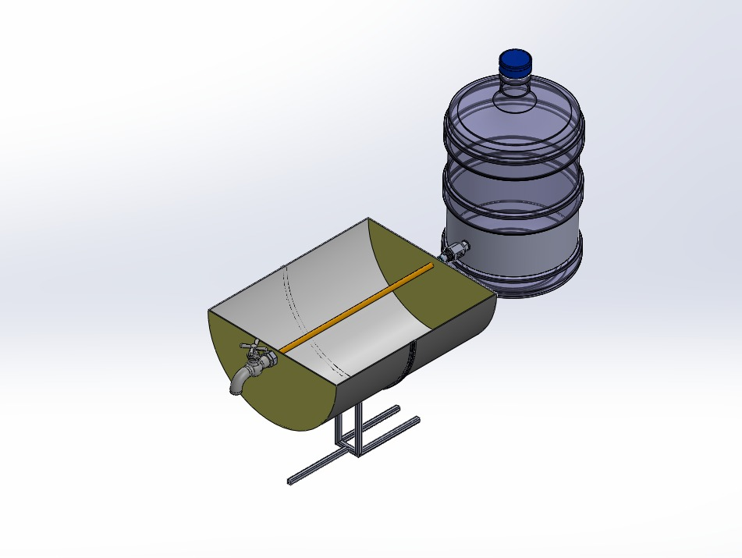
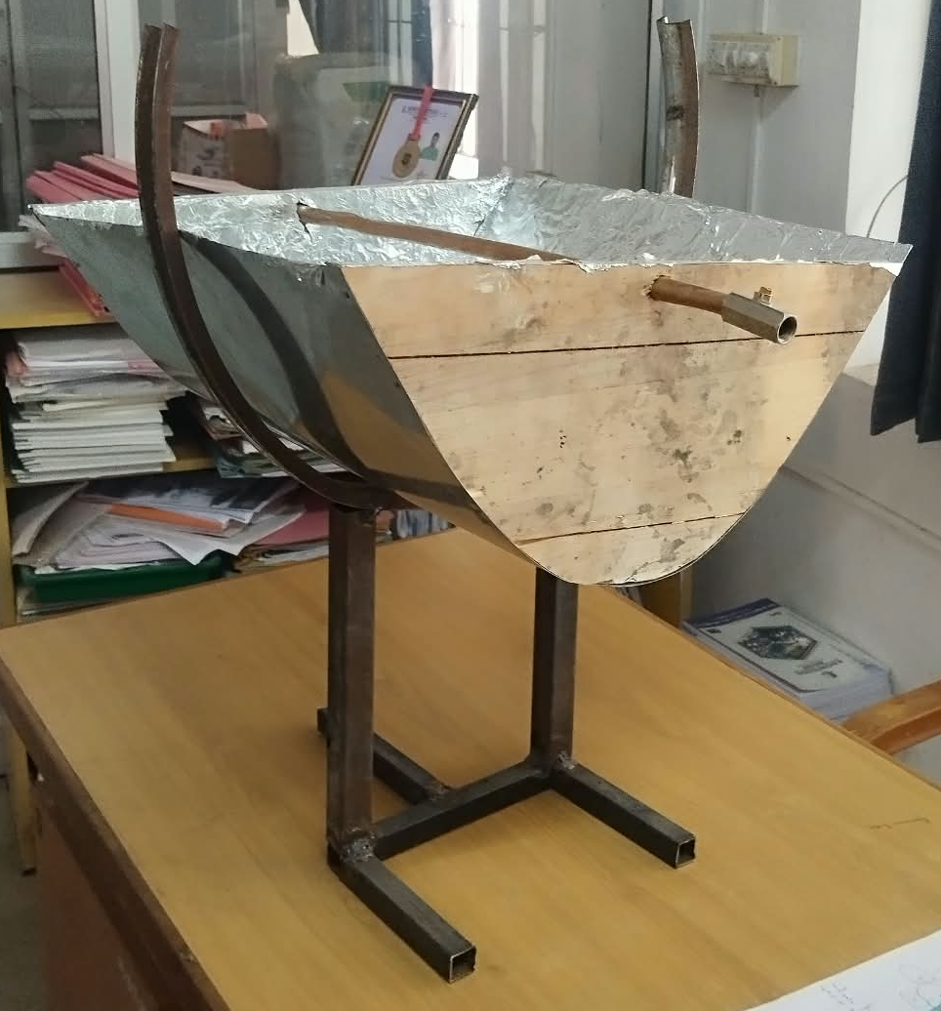
KNOWLEDGE INSTITUTE OF TECHNOLOGY
Design And Fabrication of a Parabolic Solar Water Heater Using Copper Pipe
Objective: To design and fabricate a mechanically operated solar water heater that heats water using concentrated solar radiation without sensors, electronics or electrical heaters.
Solution: A parabolic trough reflector (wooden frame, curved metal sheet, aluminium reflective sheet) concentrating sunlight onto a copper pipe positioned at the 73 mm focal line.
2

Slide 3
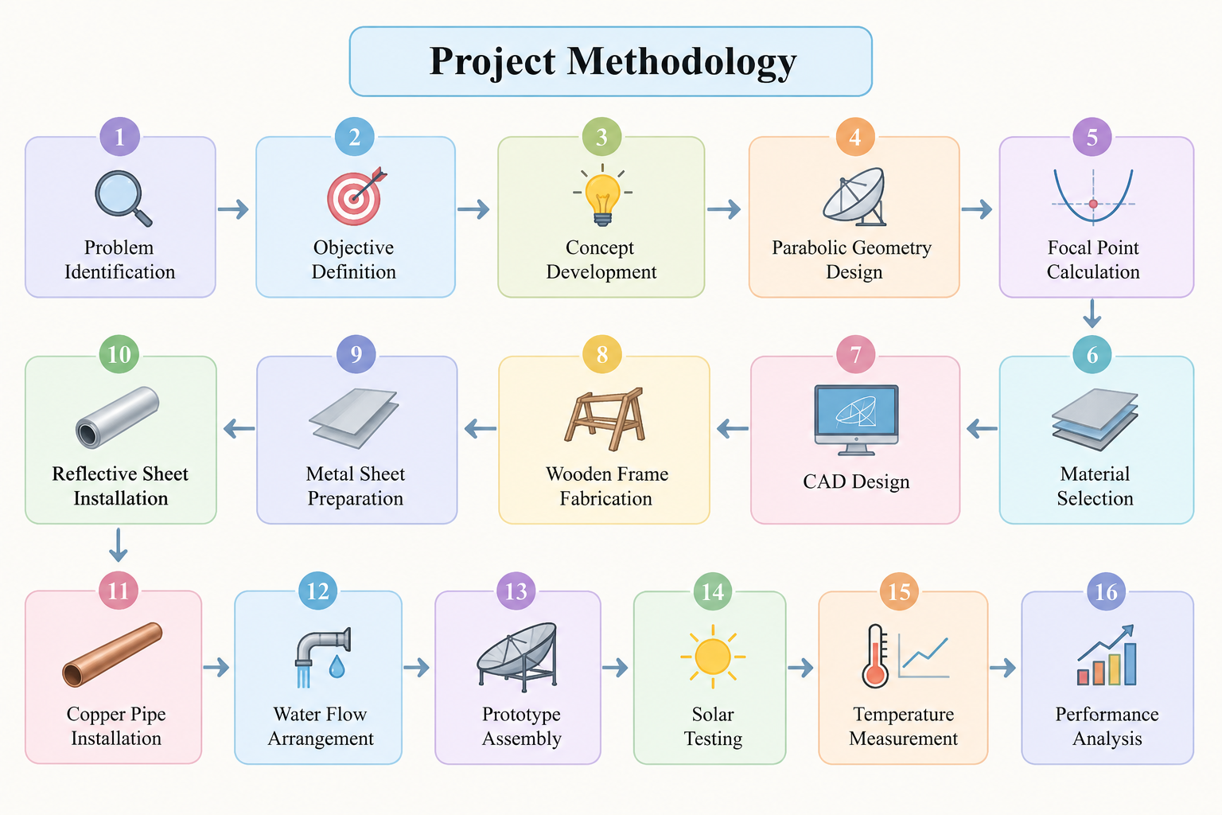
KNOWLEDGE INSTITUTE OF TECHNOLOGY
Project Methodology
1
3

Slide 4
KNOWLEDGE INSTITUTE OF TECHNOLOGY
Process Table
Phase
Activity
Outcome
Parabolic Reflector Design
Determine focal length using x2 = 4fy
Focal point fixed at 73 mm above the vertex
Wooden Frame Fabrication
Wood cut and shaped to the parabolic template
Structural rigidity and correct curvature maintained
Reflective Sheet Installation
Aluminium foil sheet fixed over the metal surface
Maximizes reflection of sunlight toward the focal region
Copper Pipe Positioning
Pipe mounted at the focal line with adjustable supports
Concentrated solar radiation directly heats the pipe
Temperature Logging
Inlet and outlet water temperatures measured at intervals
Data used to compute heat gain and thermal efficiency
4

Slide 5
KNOWLEDGE INSTITUTE OF TECHNOLOGY
List of Activities
Literature Study: Reviewed solar thermal collectors, parabolic trough geometry, and copper-receiver heat transfer performance.
Prototype Fabrication: Built a wooden-frame parabolic trough with curved metal sheet, aluminium reflective surface, and copper pipe receiver.
Focal Point Calibration: Positioned and adjusted the copper pipe at the calculated 73 mm focal distance using pipe-support brackets.
Testing and Analysis: Recorded inlet/outlet water temperatures across trials; computed useful heat gain and thermal efficiency.
5

Slide 6
KNOWLEDGE INSTITUTE OF TECHNOLOGY
Activity Precedence Table
Activity
Preceded By
Logic
Reflector Fabrication
Design and Geometry Calculation
Construction starts after focal length and profile are finalized
Copper Pipe Installation
Reflector Fabrication
Pipe mounted only after the reflector structure is complete
Outdoor Testing
Copper Pipe Installation
Testing begins once the pipe is positioned at the focal line
Data Analysis
Outdoor Testing
Thermal performance calculated after sufficient trial data
7

Slide 7
KNOWLEDGE INSTITUTE OF TECHNOLOGY
Glossary
Solar Concentration:
Focusing incident solar radiation onto a smaller receiver area using a reflective surface.
Parabolic Reflector:
A curved surface following a parabolic profile that reflects parallel rays to a common focal point.
Focal Point:
Point on the axis of symmetry at which reflected solar radiation converges.
Copper Pipe (Receiver):
Absorbs concentrated radiation and transfers heat to flowing water; high conductivity (~385 W/m.K).
Thermal Efficiency:
Ratio of useful heat gained by the water to the total incident solar energy on the aperture.
Aperture Area:
Effective area of the reflector that intercepts and collects incident solar radiation.
8

Slide 8
KNOWLEDGE INSTITUTE OF TECHNOLOGY
Science Principles
Heat Transfer (Conduction & Convection):
Solar radiation heats the copper pipe wall by conduction; heat is transferred to flowing water by convection.
Reflection Geometry (Parabola):
Parallel incident rays reflect toward a single focal point, per the parabolic equation x2 = 4fy.
Optical Concentration:
A wide aperture area concentrates solar energy onto a small receiver, raising its temperature above ambient levels.
Thermal Resistance:
Thin copper wall and high conductivity keep conduction resistance low; convective resistance inside the pipe governs heat transfer.
9

Slide 9
KNOWLEDGE INSTITUTE OF TECHNOLOGY
Concept Rules and Laws
Parabolic Equation: x2 = 4fy — defines the reflector curvature; focal length f = 73 mm generates the wooden templates.
Useful Heat Gain: Q = m x Cp x Delta T — quantifies the heat absorbed by water between inlet and outlet.
Thermal Efficiency Rule: eta = Qdot / (I x A) — ratio of useful thermal power to incident solar power on the aperture.
Heat Loss Rule: Q_loss = h x As x (Tp - Ta) — convective losses increase with pipe surface temperature and wind exposure.
Focal Sensitivity Principle: Receiver displacement beyond about 15 mm from the true focal line causes significant performance loss.
10

Slide 10
KNOWLEDGE INSTITUTE OF TECHNOLOGY
Key Equations
System Logic Model
Solar Radiation >> Parabolic Reflector >> Focal Concentration >> Copper Pipe >> Hot Water
Solar Heat Gain: Q = m x Cp x Delta T (m = mass of water; Cp = specific heat 4186 J/kg.K; Delta T = Tout - Tin)
Thermal Efficiency: eta = Qdot / (I x A) (Qdot = useful thermal power; I = solar irradiance; A = aperture area)
Parabolic Equation: x2 = 4fy -- f = 73 mm defines the reflector curvature
Result: Delta T up to 22 degree C observed (60 min exposure); confirms effective solar concentration and heat transfer
12

Slide 11
KNOWLEDGE INSTITUTE OF TECHNOLOGY
What-If Analysis
Q1:
What if solar irradiance is low (cloudy)?
Useful heat gain decreases proportionally; a longer exposure time is needed to reach the target temperature rise.
Q2:
What if the copper pipe is misaligned from the focal line?
Reflected rays miss the receiver; performance drops sharply beyond about 15 mm of displacement.
Q3:
What if wind speed increases?
Convective heat loss from the pipe surface increases, reducing net useful heat gain at constant irradiance.
Q4:
What if the reflective sheet develops wrinkles?
Rays scatter instead of concentrating; focal intensity drops, reducing the water temperature rise.
13

Slide 12
KNOWLEDGE INSTITUTE OF TECHNOLOGY
Conclusion
The project successfully designed and fabricated a mechanically operated parabolic solar water heater using a copper pipe receiver. The parabolic reflector concentrates sunlight onto the focal region, increasing the pipe temperature and transferring heat to the flowing water. The system is simple, low-cost, and operates without electricity, sensors, or electronic components. The prototype demonstrates the potential of solar concentration for small-scale water heating applications. Future improvements can include better reflective materials, insulation, accurate focal positioning, and sun-tracking mechanisms to improve thermal efficiency.
Thank You
14

